Slide 1

Market Failure
What is Market Failure
Why market fails?
Four main sorts of market failure
HS201

Slide 2

Market Failure
Market failure is the economic condition defined by an ineffective distribution of goods and services in the free market.

Slide 3
Four main sorts of market failure
Four main sorts of Market Failures are :
1. Externality
2. Public goods
3. Market control
4. Imperfect information in the market.

Slide 4
What is an Externalities
Externalities can be considered as unpriced goods involved in either consumer or producer market transactions. Air pollution from motor vehicles is one example.
Positive externalities are benefits that are infeasible to charge to provide; negative externalities are costs that are infeasible to charge to not provide.

Slide 5
Meaning of Public Goods
Public goods are such commodities or services that are obtainable to all members of society.
These are goods that do not become more rare/scarce when people use them.
Nonrivalrous
Nonexcludable

Slide 6
An overview of the different types of goods that have been distinguished
Characteristic | Rivalrous | Non-rivalrous
Excludable | Private goods (homesteads, bathroom cleaner) | Club goods (Sports clubs, movie theatres)
Non-excludable | Common resource goods (fish stocks) | Public goods: local (fire protection), national (national defence), global (climate mitigation measures), partial (parades)
Source: Stanford Encyclopedia of Philosophy

Slide 7
Monopoly and Market Failure
Monopoly leads to the following:
A lower quantity of goods produced and consumed than in a competitive market.
A higher price than the equilibrium price in a competitive market.
A higher profit for the firm.
In a monopoly, a firm will typically make greater than zero economic profit (remember that term?).

Slide 8
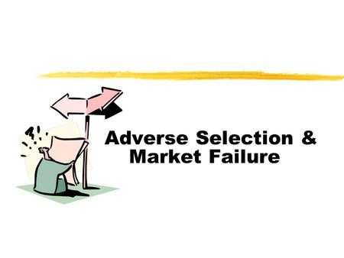
Asymmetric information (AI) and Market Failure
Adverse selection is a term used in economics that refers to a process in which undesired results occur when buyers and sellers have access to different/imperfect information, also known as asymmetric information.
Asymmetric information causes an imbalance of power.
A moral hazard is a situation where a party will take risks because the cost that could incur will not be felt by the party taking the risk.
A lack of equal information causes economic imbalances that result in adverse selection and moral hazards. All of these economic weaknesses have the potential to lead to market failure.
Source: Boundless. “Asymmetric Information: Adverse Selection and Moral Hazard.” Boundless Economics. Boundless, 08 Aug. 2016. Retrieved 26 Oct. 2016 from https://www.boundless.com/economics/textbooks/boundless-economics-textbook/challenges-to-efficient-outcomes-15/sources-of-inefficiency-83/asymmetric-information-adverse-selection-and-moral-hazard-318-12415/
Adverse selection is a term used in economics that refers to a process in which undesired results occur when buyers and sellers have access to different/imperfect information, also known as asymmetric information.
Asymmetric information causes an imbalance of power.
A moral hazard is a situation where a party will take risks because the cost that could incur will not be felt by the party taking the risk.
A lack of equal information causes economic imbalances that result in adverse selection and moral hazards. All of these economic weaknesses have the potential to lead to market failure.
Source: Boundless. “Asymmetric Information: Adverse Selection and Moral Hazard.” Boundless Economics. Boundless, 08 Aug. 2016. Retrieved 26 Oct. 2016 from https://www.boundless.com/economics/textbooks/boundless-economics-textbook/challenges-to-efficient-outcomes-15/sources-of-inefficiency-83/asymmetric-information-adverse-selection-and-moral-hazard-318-12415/
Adverse selection is a term used in economics that refers to a process in which undesired results occur when buyers and sellers have access to different/imperfect information, also known as asymmetric information.
Asymmetric information causes an imbalance of power.
A moral hazard is a situation where a party will take risks because the cost that could incur will not be felt by the party taking the risk.
A lack of equal information causes economic imbalances that result in adverse selection and moral hazards. All of these economic weaknesses have the potential to lead to market failure.
Source: Boundless. “Asymmetric Information: Adverse Selection and Moral Hazard.” Boundless Economics. Boundless, 08 Aug. 2016. Retrieved 26 Oct. 2016 from https://www.boundless.com/economics/textbooks/boundless-economics-textbook/challenges-to-efficient-outcomes-15/sources-of-inefficiency-83/asymmetric-information-adverse-selection-and-moral-hazard-318-12415/
Adverse selection is a term used in economics that refers to a process in which undesired results occur when buyers and sellers have access to different/imperfect information, also known as asymmetric information.
Asymmetric information causes an imbalance of power.
A moral hazard is a situation where a party will take risks because the cost that could incur will not be felt by the party taking the risk.
A lack of equal information causes economic imbalances that result in adverse selection and moral hazards. All of these economic weaknesses have the potential to lead to market failure.
Source: Boundless. “Asymmetric Information: Adverse Selection and Moral Hazard.” Boundless Economics. Boundless, 08 Aug. 2016. Retrieved 26 Oct. 2016 from https://www.boundless.com/economics/textbooks/boundless-economics-textbook/challenges-to-efficient-outcomes-15/sources-of-inefficiency-83/asymmetric-information-adverse-selection-and-moral-hazard-318-12415/
Asymmetric information (AI) leads to the following situation - adverse selection, moral hazards, and market failure.
· Adverse selection is a term used in economics that refers to a process in which undesired results occur when buyers and sellers have access to different/imperfect information, also known as asymmetric information. Asymmetric information causes an imbalance of power.
· A situation where a party will take risks because the cost that could incur will not be felt by the party taking the risk is considered as a moral hazard .
· A lack of equal information causes economic imbalances that result in adverse selection and moral hazards. All of these economic weaknesses have the potential to lead to market failure.

Slide 9
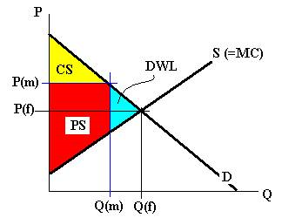
Deadweight Loss
In a competitive market, wealth is the sum of the red, yellow, and blue areas. In the monopoly market, it is just the sum of the yellow and red areas. The blue area is wealth that is lost to society. This area is the Deadweight Loss. This labeled as "DWL" in Figure 5.1. This is the cost to a society of allowing a monopoly to operate. So, in a monopoly, the producer makes more, the consumer makes less, and the society, added together, is poorer as a result.
This is called a Social Cost: a cost to the total society.

Slide 10
MARKET GOVERNMENT GOVERNMENT
FAILURE INTERVENTION FAILURE
EXTERNALITY PUBLIC ENTERPRISE ADMINISTRATIVE
-PUBLIC GOODS-NATIONALIZATION COST
MARKET -PRIVATIZATION COMPLIANCE
POWER REGULATION COST
INEQUITIES - OUTPUT EFFICIENCY COST
DYNAMIC - PRICE - NEGATIVE EXTER.
MKT. FAIL. - STANDARDS -PUBLIC BADS
INDIVISIBILITY ANTITRUST - MKT POWER
INFORMATION -STRUCTURE - INEQUITIES
ASYMMETRY -CONDUCT - DYNAMIC
TAXES (SUBSIDIES) - INDIVISIBILITY
PROVISION OF - INFORMATION
INFORMATION
RATIONING (MONEY)

